Slide 1
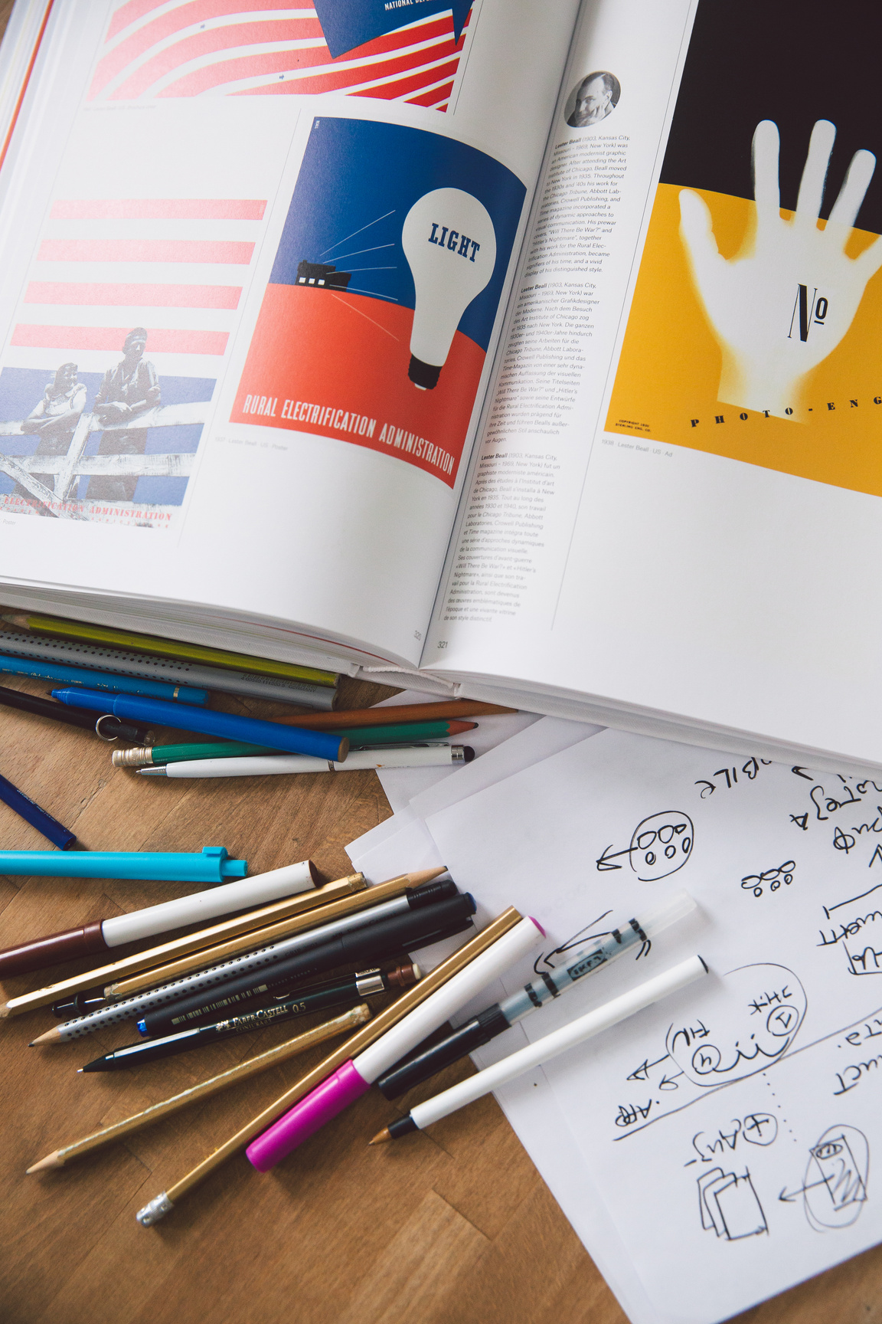
Research Productivity:
Teachers can research, too!
Tosh Tachino
Oberlin University
tachino_t@obirin.ac.jp
Julia Kimura
Mukogawa Women’s University
jkimura@mukogawa-u.ac.jp
27 Jue, 2
This PowerPoint is available at:
https://toshtachino.com/oberlin2025/
Notes:
Julie will do intro.

Slide 2

Introduction
What productivity issues are you facing?
What productivity habits and strategies do you practice?
Notes:
Tosh

Slide 3

Individual Factors
Ascriptive factors: age, gender, ethnicity, L1, family situation, life events, etc.
Achievement factors: education, training, rank, years of experience, etc.
Psychological factors: motivation, self-efficacy, autonomy, time management, etc.
Institutional Factors
e.g. resources, policies, culture, colleagues, etc.
Environmental Factors
national policy, external funding, economy,
etc.
Types of Factors

Slide 4

Writing Habits
Strategies
Create a regular writing schedule (Boice, 1989, 1990, 2000).
Establish routines (specific locations, cues, rituals, reminders, etc.) (DeFeo, et al., 2016).
Set up an accountability system (writing groups, writing coach, writing partner, etc.) (Morss & Murray, 2001).
Celebrate after daily wins. Consider rewarding yourself (Fogg, 2020).
Role of Writing Habits
Boice (1989, 1990, 2000), DeFeo et al. (2016), Morss & Murray (2001)
Notes:
Evidence (that regular writing is more effective than sporadic/spontaneous)
Boice (1989): academic writers who engaged in brief daily writing produced significantly more pages than those who waited for large blocks of time (“binge writers”).
Boice (1990): pp. 79ff: Of the 27 faculty members, regular writers wrote more productive
DeFeo et al. (2016): Writing groups shifted participants’ focus from external pressures to healthy habits and identity as writers.
Morss & Murray (2001): Structured Writing for Publication program yielded both hard and soft results (greater output and self-efficacy)

Slide 5

Time Management
Strategies
Schedule and protect your writing time (Boice, 2000).
Manage your teaching and administrative loads (Roberts & Turnbull, 2004).
Stagger your research projects (Murray, 2014).
Use the Eisenhower matrix: Don’t forget the “important but not urgent” (Covey, 1989).
Know your daily energy pattern and do your writing at the right time of the day (Pink, 2018).
Role of Time Management
Englebrecht et al. (2008), Martínez et al. (2011), Mayrath (2007); Roberts & Turnbull (2004)
Notes:
Evidence
Englebrecht et al. (2008): 487 accounting doctoral students for the next 20 years: Positive correlation = top-tier institutions of first hire, larger department size of initial hire, and the experience within academic ranks. Negative = increased time spent teaching and accepting an initial hire at a public rather than a private institution.
Martínez et al. (2011): 94 highly productive scholars of school psychology: yielded following recommendations:
Follow your bliss, be persistent, and work really hard.
Collaborate
Manage your schedule wisely and prioritize research responsibilities
Have a protected time to write and become a student of writing
Pursue a systemic line of research that cultivates your expertise
Hone research skills, stay current in the literature, and become a reviewer
Take peer reviews seriously without getting defensive, and address revisions thoroughly
Familiarize yourself with the journals and select and outlet based on fit and intended audience
Mayrath (2007): 13 productive authors in educational psychology. Common attributes: collaboration, passion/curiosity, research skills, and time management.
Roberts & Turnbull (2004): among nursing faculty: time management is important, lack of time (high teaching load) as a barrier to scholarly productivity

Slide 6

Self-Efficacy
Strategies
Build success by actually succeeding in manageable tasks (Nordin et al., 2017).
Watch what others do to succeed (Lockwood & Kunda, 1997).
Get feedback and encouragement from trusted colleagues, mentors, or supervisors (Wester et al., 2020).
Role of Self-Efficacy
Bandura (1997), Vrugt & Koenis (2002), Jonas & Hall (2022)
Notes:
Evidence (that it contributes to research productivity):
Brown et al. (1996): a study with graduate students
Jonas & Hall (2022): a study with 851 graduate students
Vrugt & Koenis (2002): a study with 123 academics

Slide 7

Social Support
Strategies
Join a research group (Martínez et al., 2011).
Seek a critical colleague (Verla Uchida & Roloff Rothman, 2023).
Set “social” deadlines:
Enter a pact with a peer.
Set a date to send your manuscript for feedback (Mayrath, 2007).
Role of Social Support
Martínez, Floyd & Erichsen, 2011;
Mayrath, 2007;
Verla Uchida & Roloff Rothman, 2023
Notes:
- social support
- research collaboration
- networking
- attitudes
- professional development

Slide 8
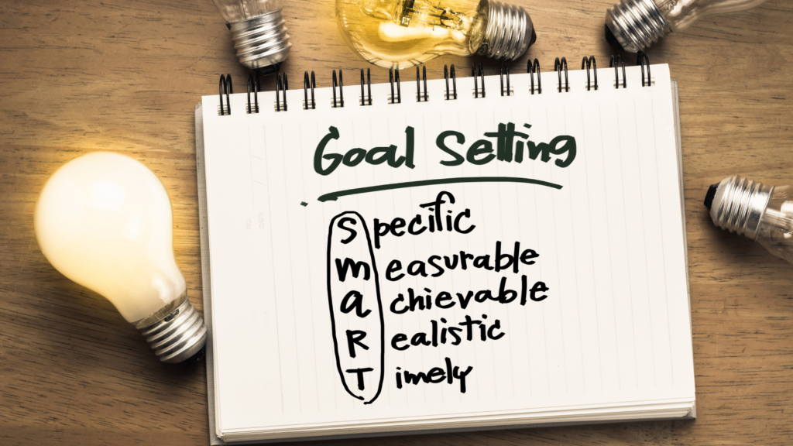
Goal Setting
Strategies
Set specific and challenging yet achievable goals (Locke & Latham, 2002).
Consider both performance goals and learning goals (Swann, et al., 2020).
Define final goals and break them into smaller short-term goals (Morisano, 2020).
Have an objective measurement of progress and track it (Locke & Latham, 2002).
Visualize and mentally perform specific tasks (Oettingen, 2012).
Have a very small goal that you will achieve today! (Fogg, 2020)
Role & Mechanism of Goal-Setting
Bandura (1997), Locke & Latham (2002), Morisano et al. (2010), Fogg (2020)
Notes:
Evidence
No specific evidence on whether or not goal setting affects the scholarly productivity of faculty members.
Locke & Latham (2002): a detailed overview of how goals affect performance
Morisano et al. (2010): Goal-setting interventions improved student academic performance
Swann, et al. (2020). Learning goals may be better suited when the (assigned) performance goal is too difficult.
Make it SMART: Specific, Measurable, Achievable, Relevant, Time-bound.

Slide 9

Research Collaboration
Strategies
Coauthor papers (Martínez et al., 2011).
Join a research group (Levett & Thelwall,
Collaborate and network to boost productivity (Kiewra, Luo, & Flanigan, 2021).
Seek international collaborators if you can (Kweik, 2015)
Role of Collaboration
Baulant, 2017;
Kiewra, Luo, & Flanigan, 2021;
Martínez, Floyd, & Erichsen, 2011;
Notes:
Participating in research groups is a normal part of grad school life here. Joining a research group will not only increase output, thanks to synergy, but funding bodies value collaborative research projects more because they tend to be cited more.

Slide 10

Networking
Strategies
Seek happiness! You may become more efficient when you network (Baulant, 2017).
Foster relationships and collaborate! This is a common strategy that accounts for high productivity (Martínez et al., 2011).
Promise yourself to make an effort to put out your feelers the next time you attend a conference.
Remember what you can offer to others.
Keep your mind open to what others can offer you.
Role of Networking
Baulant, 2017;
Martínez, Floyd, & Erichsen, 2011;
Notes:
Networking can feel smarmy.

Slide 11

Attitudes
Strategies
Remember that beliefs shape choices we make in the producing academic output (Nygaard, 2017).
Remember that mere perceptions of PoP affect productivity—for better and for worse (van Dalen & Henkens, 2012)
Think about Boice’s (1994) Rules of the Road for Writers
Role of Attitude
Boice, (1994);
Nygaard, 2017;
van Dalen & Kenkens (2012)
Notes:
This may sound terribly conceited, but how about a picture of you and me high-fiving?
Also, memo to self: Be open about your difficulty with positive psychology’s relationship with neoconservatism.

Slide 12
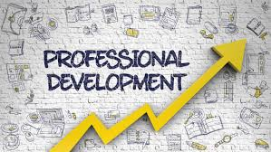
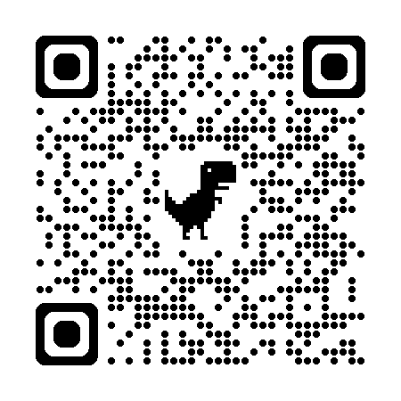
Professional Development
Strategies
Find a mentor (Shen et al., 2022).
Find a mentee (Kimura, 2025).
Learn new skills
Attend workshops and conferences
Join us for Zoom for Professional Development!
And OTJ’s FNS!
Role of Professional Development
Kimura (Unpublished manuscript),
Shen et al. (2022)

Slide 13
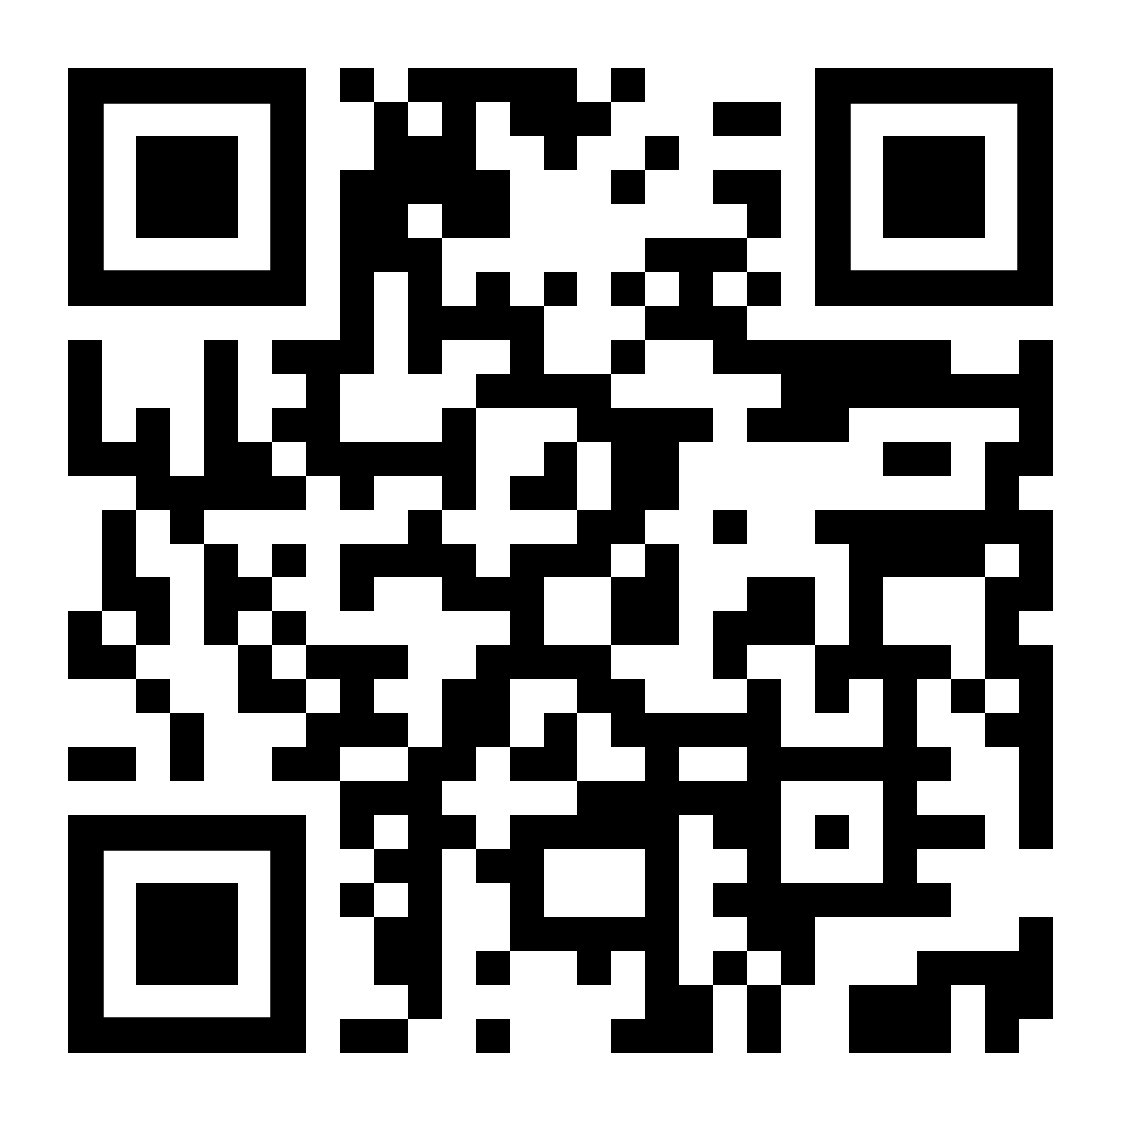
Please help us help you by participating our survey on research productivity of TEFL academics in Japanese universities.
Let’s Keep in Touch
Find this PowerPoint at:
https://toshtachino.com/oberlin2025/
Tosh Tachino
Oberlin University
tachino_t@obirin.ac.jp
Julia Kimura
Mukogawa Women’s University
jkimura@mukogawa-u.ac.jp
27 Jue, 2
Notes:
Julie will do intro.

Slide 14
References (p. 1)
Bandura, A. (1997). Self-efficacy: The exercise of control. Macmillan.
Baulant, A. (2017). How can happiness lead to more efficiency? A new paradigm adapted to the new world knowledge economy. American Review of Political Economy. 11(2). 111–125.
Boice, R. (1989). Procrastination, busyness and bingeing. Behaviour Research and Therapy, 27(6), 605–611. https://doi.org/10.1016/0005-7967(89)90144-7
Boice, R. (1990). Professors as writers: A self-help guide to productive writing. New Forums Press.
Boice, R. (1994). How writers journey to comfort and fluency: A psychological adventure. Praeger.
Boice, R. (2000). Advice for new faculty members: Nihil nimus. Allyn & Bacon.
Brown, S. D., Lent, R. W., Ryan, N. E., & McPartland, E. B. (1996). Self-efficacy as an intervening mechanism between research training environments and scholarly productivity: A theoretical and methodological extension. The Counseling Psychologist, 24(3), 535–544. https://doi.org/10.1177/0011000096243012
Covey, S. R. (1989). The 7 habits of highly effective people. Fireside.
DeFeo, D. J., Kılıç, Z., & Maseda, R. (2016). From productivity to process: Flipping the writing group. Academic Journal of Interdisciplinary Studies, 5(3), 544–550. https://doi.org/10.5901/ajis.2016.v5n3s1p544
Englebrecht, T. D., Bisping, T., Anderson, M. M., & Hasselback, J. R. (2008). A further inquiry into the scholarly productivity of academic accountants: Twenty years of evidence from classes of 1980–82. Advances in Accounting, 24(1), 24–31. https://doi.org/10.1016/j.adiac.2008.05.005
Fogg, B. J. (2020). Tiny habits: The small changes that change everything. Harvest.
Notes:
This may sound terribly conceited, but how about a picture of you and me high-fiving?
Also, memo to self: Be open about your difficulty with positive psychology’s relationship with neoconservatism.

Slide 15
References (p. 2)
Jonas, E. A., & Hall, N. C. (2022). Writing and reading self-efficacy in graduate students: Implications for psychological well-being. Interdisciplinary Education and Psychology, 3(1), 3–17.
Kiewra, K. A., Luo, L., & Flanigan, A. E. (2021). Educational psychology early career award winners: How did they do it?. Educational Psychology Review, 33(4), 1981–2018. https://doi.org/10.1007/s10648-021-09619-4
Kimura, J. (2025). Publish or perish in Japan? Barriers and enablers for female ELT professionals.
Levett, J. M.,& Thelwall, M. (2016). Long term productivity and collaboration in information science. Scientometrics. 1103–1117. https://doi.org/10.1007/s11192-016-2061-8
Locke, E. A., & Latham, G. P. (2002). Building a practically useful theory of goal setting and task motivation: A 35-year odyssey. American Psychologist, 57(9), 705–717. https://doi.org/10.1037/0003-066X.57.9.705
Lockwood, P., & Kunda, Z. (1997). Superstars and me: Predicting the impact of role models on the self. Journal of Personality and Social Psychology, 73(1), 91–103. https://doi.org/10.1037/0022-3514.73.1.91
Martínez, R. S., Floyd, R. G., & Erichsen, L. W. (2011). Strategies and attributes of highly productive scholars and contributors to the school psychology literature: Recommendations for increasing scholarly productivity. Journal of School Psychology, 49(6), 691–720. https://doi.org/10.1016/j.jsp.2011.10.003
Mayrath, M. C. (2008). Attributions of productive authors in educational psychology journals. Educational Psychology Review, 20(1), 41–56. https://doi.org/10.1007/s10648-007-9059-y
Notes:
This may sound terribly conceited, but how about a picture of you and me high-fiving?
Also, memo to self: Be open about your difficulty with positive psychology’s relationship with neoconservatism.

Slide 16
References (p. 3)
Morisano, D., Hirsh, J. B., Peterson, J. B., Pihl, R. O., & Shore, B. M. (2010). Setting, elaborating, and reflecting on personal goals improves academic performance. Journal of Applied Psychology, 95(2), 255–264. https://doi.org/10.1037/a0018478
Morss, K., & Murray, R. (2001). Researching academic writing within a structured programme: Insights and outcomes. Studies in Higher Education, 26(1), 35–52. https://doi.org/10.1080/03075070020030706
Murray, R. (2014). Writing in social spaces: A social processes approach to academic writing. Routledge. https://doi.org/10.4324/9781315755427
Nygaard, N. (2017). Publishing and perishing: An academic literacies framework for investigating research productivity. Studies in Higher Education, 42(3), 519–532. https://doi.org/10.1080/03075079.2015.1058351
Oettingen, G. (2012). Future thought and behaviour change. European Review of Social Psychology, 23(1), 1–63. https://doi.org/10.1080/10463283.2011.643698
Pink, D. H. (2019). When: The scientific secrets of perfect timing. Penguin.
Roberts, K. (Kathryn L. ), & Turnbull, B. J. (2004). Nurse-academics’ scholarly productivity: Perceived frames and facilitators. Contemporary Nurse, 17(3), 282–292. https://doi.org/10.5172/conu.17.3.282
Notes:
This may sound terribly conceited, but how about a picture of you and me high-fiving?
Also, memo to self: Be open about your difficulty with positive psychology’s relationship with neoconservatism.

Slide 17
References (p. 4)
Shen, M. R., Tzioumis, E., Andersen, E., Wouk, K., McCall, R., Li, W., Girdler, S., & Malloy, E. (2022). Impact of mentoring on academic career success for women in medicine: A systematic review. Academic Medicine, 97(3), 444–458. https://doi.org/10.1097/ACM.0000000000004563
Swann, C., Rosenbaum, S., Lawrence, A., Vella, S. A., McEwan, D., & Ekkekakis, P. (2021). Updating goal-setting theory in physical activity promotion: A critical conceptual review. Health Psychology Review, 15(1), 34–50. https://doi.org/10.1080/17437199.2019.1706616
Uchida, A. V., & Rothman, J. R. (Eds.). (2023). Cultivating professional development through critical friendship and reflective practice: Cases from Japan. Candlin & Mynard.
Van Dalen, H. P., & Henkens, K. (2012). Intended and unintended consequences of a publish‐or‐perish culture: A worldwide survey. Journal of the American Society for Information Science and Technology, 63(7), 1282–1293.
Vrugt, A., & Koenis, S. (2002). Perceived self‐efficacy, personal goals, social comparison, and scientific productivity. Applied Psychology, 51(4), 593–607. https://doi.org/10.1111/1464-0597.00110
Wester, K. L., Vaishnav, S., Morris, C. W., Austin, J. L., Haugen, J. S., Delgado, H., & Umstead, L. K. (2020). Interaction of imposter phenomenon and research self‐efficacy on scholarly productivity. Counselor Education and Supervision, 59(4), 316–325. https://doi.org/10.1002/ceas.12191
Notes:
This may sound terribly conceited, but how about a picture of you and me high-fiving?
Also, memo to self: Be open about your difficulty with positive psychology’s relationship with neoconservatism.

